Slide 1
Wireless Sensor Networks
A survey on security
Trent Scott

Slide 2
What are they?

Slide 3
What are they?
Main Unit
Motes

Slide 4
Properties
Main Unit
Stronger battery/power source
Better transceiver
Motes
Omni-direction transceiver
Small battery
Microprocessor

Slide 8
Malicious
Node

Slide 9
Other Attacks

Slide 10
Other Attacks
Sensor Overloading
Sensor Fault
Malicious Commands

Slide 11
Solutions?

Slide 12
Directional Antennas
Costly
BUT
Eliminates Attacks

Slide 13
Data Integrity
Hash Algo’s
Must be efficient
Low power processing
Completed by the main unit

Slide 14
Data Integrity
No Data Loss!

Slide 15
Location Detection
Main unit detects
location of motes and
validates location changes.

Slide 16
Modern
Applications

Slide 17
Hospitals
Remote Monitoring
Command Distribution
Lower Cost
More Effective (Due to Cloud Computing)

Slide 18
Environmental Monitoring
Remote Monitoring of Conditions
Distributed Detection
Easy to Implement
Efficient

Slide 19
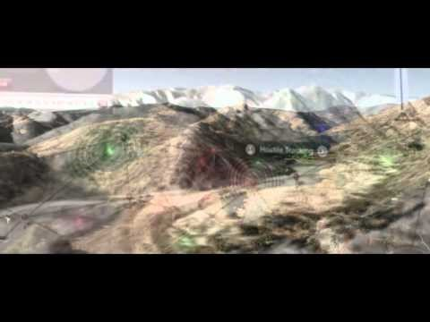
Battlefield Surveillance

Slide 20
Questions?

Slide 21
Hayajneh, Thaier, Bassam Mohd, Muhammad Imran, Ghada Almashaqbeh, and Athanasios Vasilakos. "Secure Authentication for Remote Patient Monitoring with Wireless Medical Sensor Networks." Sensors 16.4 (2016): 424. Web.
Ramos, Alex, and Raimir Filho. "Sensor Data Security Level Estimation Scheme for Wireless Sensor Networks." Sensors 15.1 (2015): 2104-136. Web.
Liau, Qian, Chee Leow, and Zhiguo Ding. "Physical Layer Security Using Two-Path Successive Relaying." Sensors 16.6 (2016): 846. Web.

